Slide 1




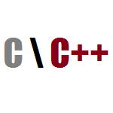







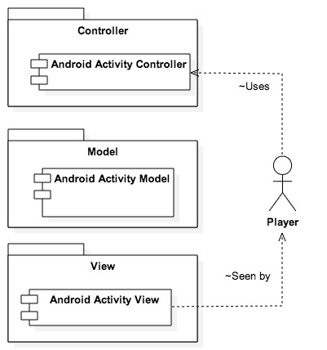
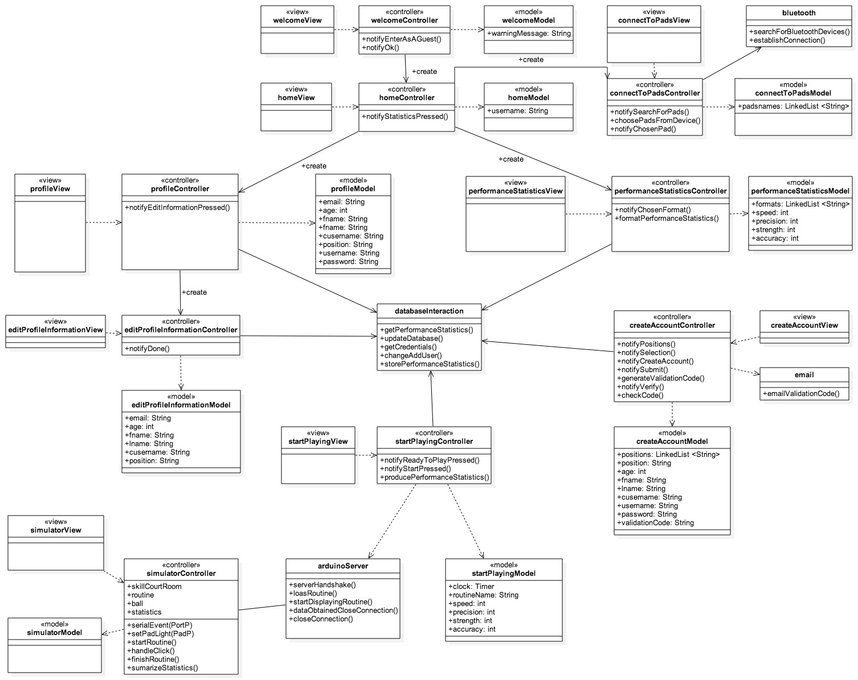
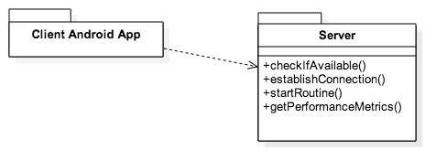
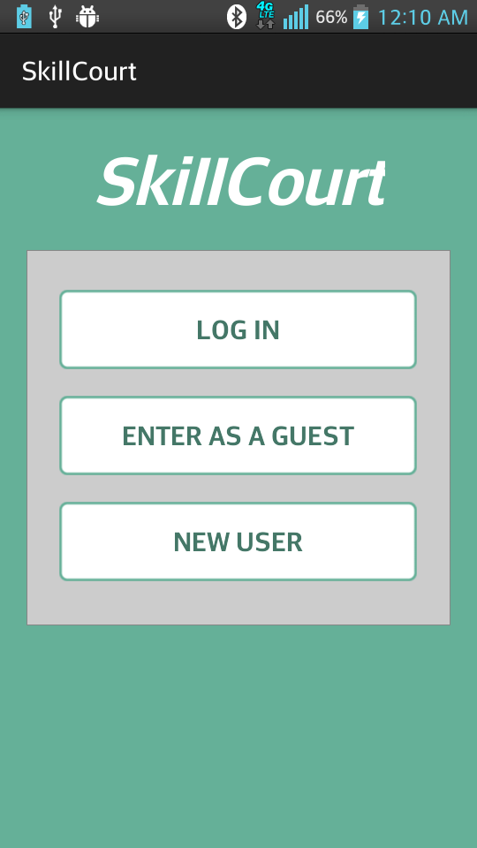
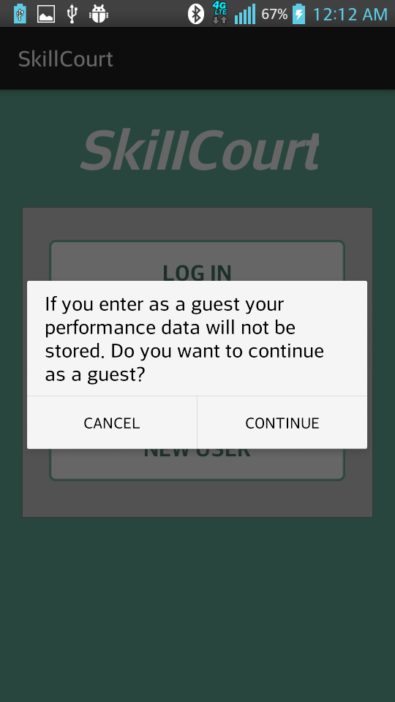
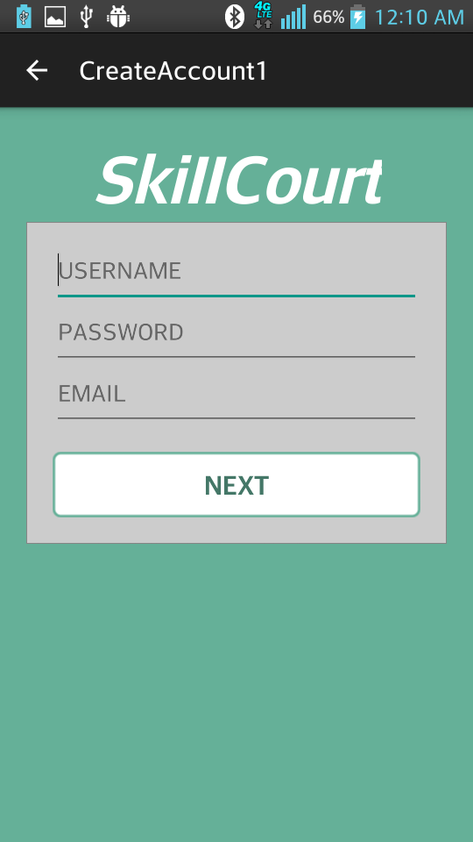
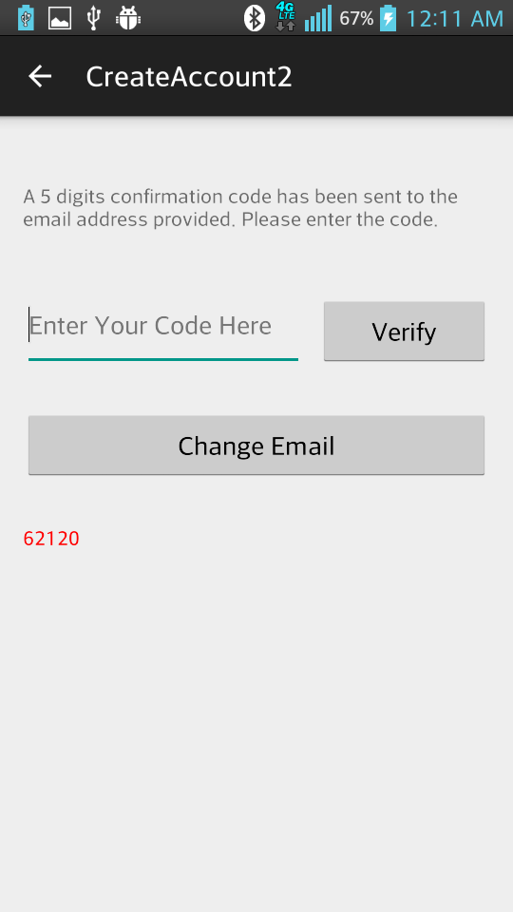
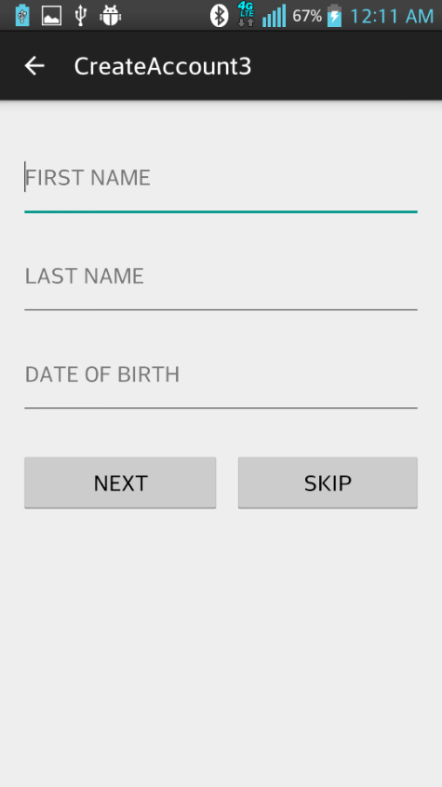
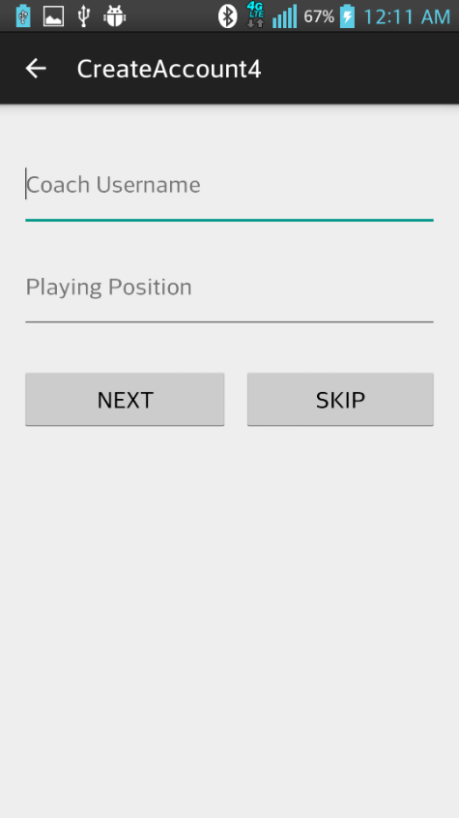
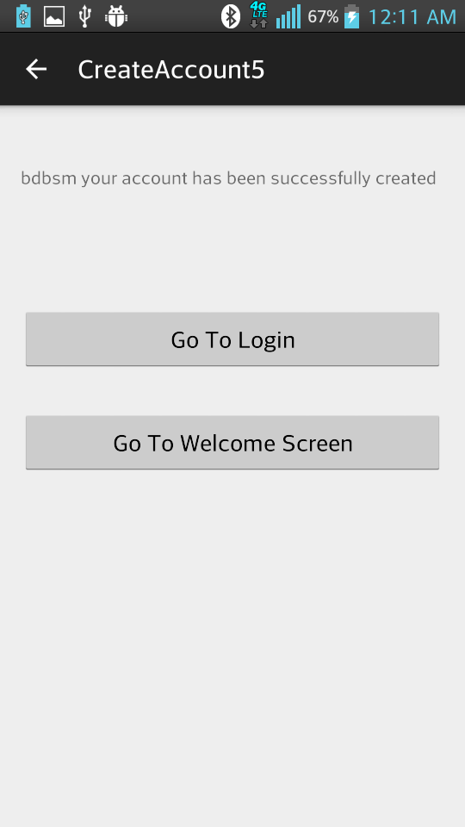
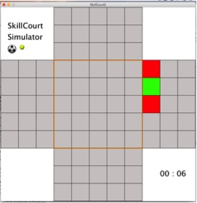
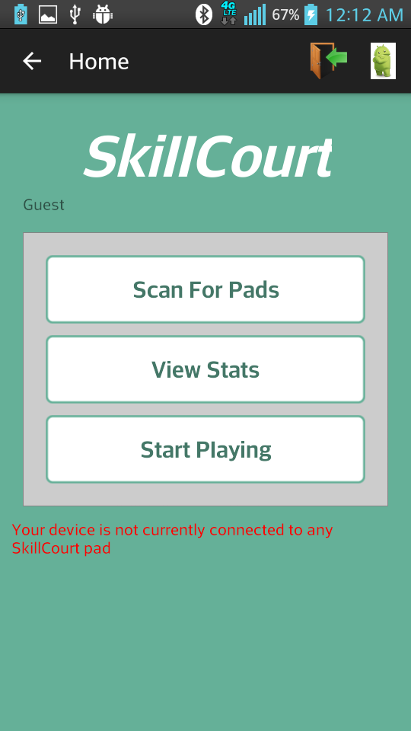
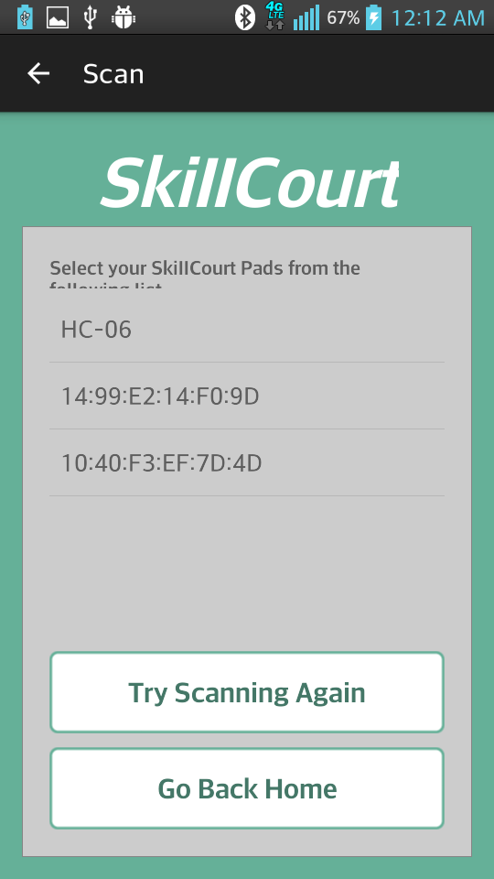
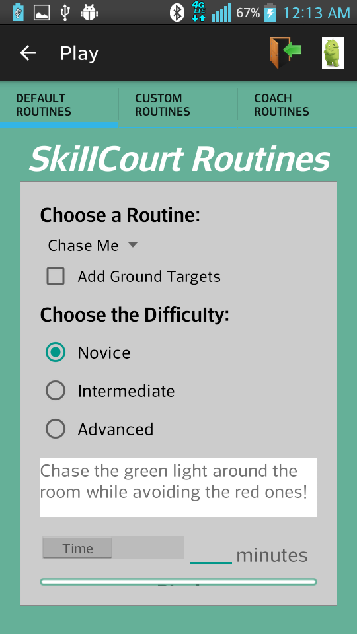
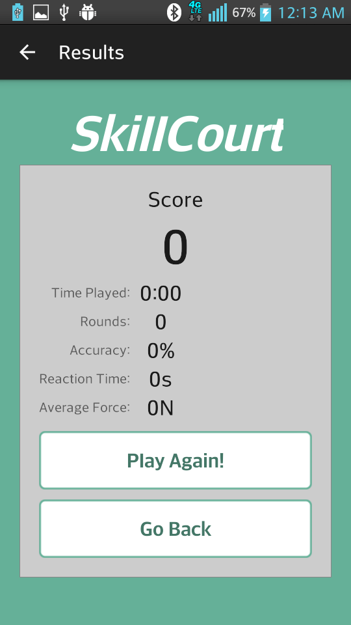
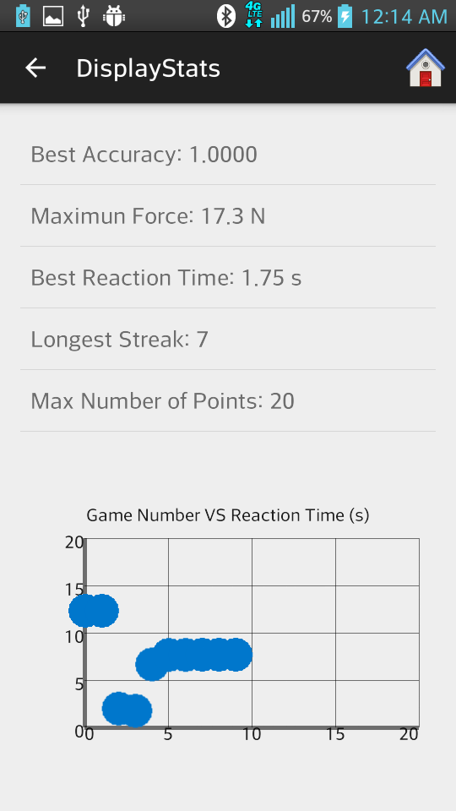
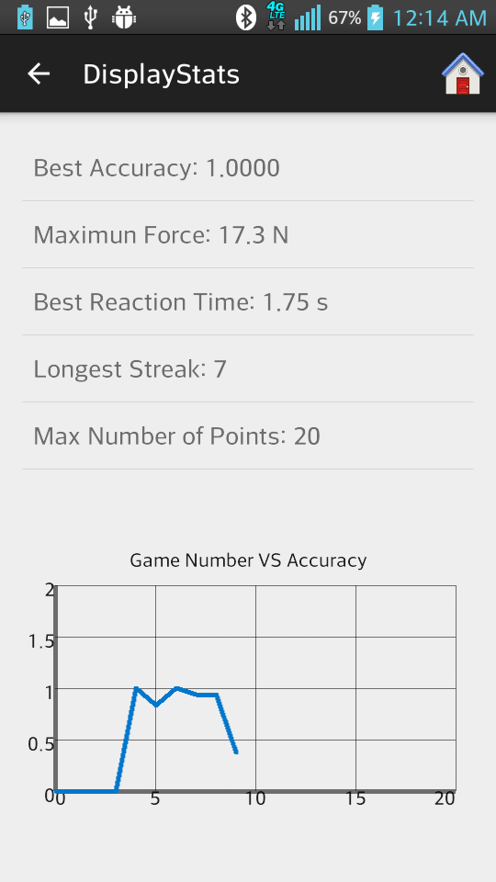
School of Computing & Information Sciences
Senior Project, 2015, Spring
SkillCourt Backend
Student: Andy D. Martinez, Florida International University
Mentor: Jaime Borras
Instructor: Masoud Sadjadi, Florida International University
Problem
Current System
Requirements
Traditionally, the way in which a soccer player trains is by interacting with teammates, the coach, and the ball in a training field. This training, however, depends on others, and the coach cannot assess all players at the same time, therefore, performance reviews are not complete.
For games like Soccer that require a big field, the availability of space is crucial to training, and lack of space to train is a major setback for individual players, as well as lower-budget soccer teams.
Additionally, it is essential for players to develop a high body-mind coordination that allows them to move and perform specific techniques without consciously thinking about it. Extensive training is needed to develop such coordination, and brain efficiency.
There are not many companies addressing this problem right now. Companies such as Axon Sports, for example, have tried to develop a training system that improves brain efficiency with games that use the touch technology. However, no customizable, interactive training system is commercially available for users to buy and use.
Functional Requirements:
The system shall allow the user to:
Create an account
Log in
Log out
Enter as a guest
View profile
Modify profile
Scan and connect to pads
Select a routine and send it to the simulator
Play the routine in the simulator
Get final performance metrics after game is over
Disconnect from pads
See his/her performance of previous games
Non-Functional Requirements:
1. The system should: verify that a device is or isn’t a pad in less than 11 seconds.
Proposed System
The proposed system, SkillCourt Backend, will be a user configurable athletic training “game” that will allow players to interact with a set of SkillCourt pads by hitting them with the ball. The player will be able to set routines in which different patterns of lights will show on the pads, and use these to improve their mind-body coordination, and agility, at the same time that they train specific skills. Additionally, the system records statistics of the player’s performance, providing a complete performance review, and the data necessary for the player to improve their skills.
System Design
Object Design
Implementation
MVC architecture:
The main objective when implementing the Android application was to make it user friendly. It was developed using Android Studio, mainly in Java and XML. When implementing the SkillCourt room simulator, the main objective was to make it behave as close to reality as possible. It was implemented using Processing, mainly in Java. The master pad was implemented using an Arduino microcontroller, in C/C++
Implemented functionalities of the simulator:
Validation of the room for a specific routine
Detection of the next random step to be played
Sensing a hit and responding appropriately
Sensing time and using it as an input
Capturing and summarizing player's performance metrics
The implemented abilities of the master pad are:
Bluetooth input and output
LED control according to routine playing
Sending command to the rest of the pads according to routine received from mobile device
Communicating performance metrics back to Android Application.
Client-Server architecture:
Verification
Screenshots
Unit Testing was performed for each of the individual components before integration. Then, the individual components were combined with the rest of the system and Integration testing was applied, to make sure that the parts corresponding to each team member were working correctly when put together. Additionally, system testing was applied to make sure that the system was behaving correctly meeting the requirements provided by the clients.
The most representative tested components were:
Sending and receiving correct data between simulator and mobile device
Updating User’s performance metrics in the database and displaying them to the user
Serial port communication between microcontroller (Master Pad) and the rest of the simulator
Summary
It is essential for Soccer players to develop a high body-mind coordination that allows them to move and perform specific techniques without consciously thinking about it. There is not a current system that allows players to interact with it in a one to one manner, in order to train specific soccer skills, and develop an efficient body-mind coordination. The proposed system intends to create such an interactive “Game” that allows the user to customize routines and train specific skills, and at the same time, improve speed, agility, accuracy, etc.
My main contribution to the project involved the Bluetooth interaction, allowing the users to create account and modify their information, building the simulator, allowing the user to access their performance statistics, and helping on the setup of the database.
Acknowledgement
The material presented in this poster is based upon the work supported by SkillCourt-Backend. I am thankful to the help that I received from my group member, Matthew Santiago, Jaime Borras and Gummy

